Slide 1

CISC360 Computer Architecture
Lesson 4
Input / Output and
External Storage

Slide 2

Why Do We care About I/O?
CPU Performance: 60% per year
I/O system performance limited by mechanical delays (disk I/O)
  < 10% per year (IO per sec or MB per sec)
Amdahl's Law: system speed-up limited by the slowest part!
  10% IO & 10x CPU => 5x Performance (lose 50%)
  10% IO & 100x CPU => 10x Performance (lose 90%)
I/O bottleneck:
  Diminishing fraction of time in CPU
  Diminishing value of faster CPUs

Slide 3
Input/Output Problems
Wide variety of peripherals
  Delivering different amounts of data
  At different speeds
  In different formats
All slower than CPU and RAM
Need I/O modules

Slide 4
Input/Output Module
Interface to CPU and Memory
Interface to one or more peripherals

Slide 5
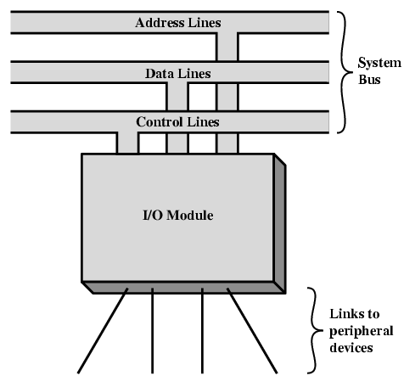
Generic Model of I/O Module

Slide 6
External Devices
Human readable
  Screen, printer, keyboard
Machine readable
  Monitoring and control
Communication
  Modem
  Network Interface Card (NIC)

Slide 7
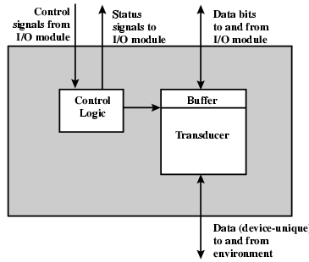
External Device Block Diagram

Slide 8
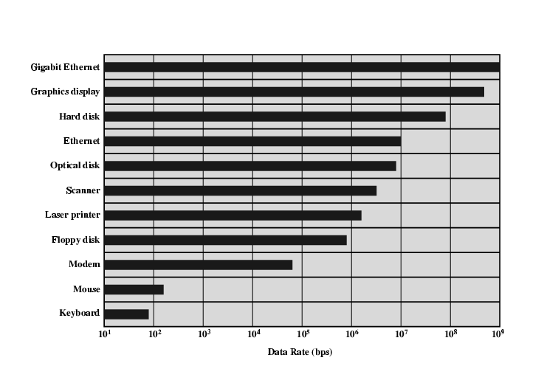
Typical I/O Data Rates

Slide 9
I/O Module Function
Control & Timing
CPU Communication
Device Communication
Data Buffering
Error Detection

Slide 10
I/O Steps
CPU checks I/O module device status
I/O module returns status
If ready, CPU requests data transfer
I/O module gets data from device
I/O module transfers data to CPU
Variations for output, DMA, etc.

Slide 11
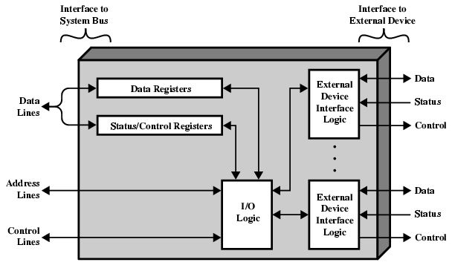
I/O Module Diagram

Slide 12
I/O Module Decisions
Hide or reveal device properties to CPU
Support multiple or single device
Control device functions or leave for CPU
Also O/S decisions
  e.g. Unix treats everything it can as a file

Slide 13
Input Output Techniques
Programmed
Interrupt driven
Direct Memory Access (DMA)

Slide 14
Programmed I/O
CPU has direct control over I/O
  Sensing status
  Read/write commands
  Transferring data
CPU waits for I/O module to complete operation
Wastes CPU time

Slide 15
Programmed I/O - detail
CPU requests I/O operation
I/O module performs operation
I/O module sets status bits
CPU checks status bits periodically
I/O module does not inform CPU directly
I/O module does not interrupt CPU
CPU may wait or come back later

Slide 16
I/O Commands
CPU issues address
  Identifies module (& device if >1 per module)
CPU issues command
  Control - telling module what to do
    e.g. spin up disk
  Test - check status
    e.g. power? Error?
  Read/Write
    Module transfers data via buffer from/to device

Slide 17
Addressing I/O Devices
Under programmed I/O data transfer is very like memory access (CPU viewpoint)
Each device given unique identifier
CPU commands contain identifier (address)

Slide 18
I/O Mapping
Memory mapped I/O
  Devices and memory share an address space
  I/O looks just like memory read/write
  No special commands for I/O
    Large selection of memory access commands available
Isolated I/O
  Separate address spaces
  Need I/O or memory select lines
  Special commands for I/O
    Limited set

Slide 19
Interrupt Driven I/O
Overcomes CPU waiting
No repeated CPU checking of device
I/O module interrupts when ready

Slide 20
Interrupt Driven I/O
Basic Operation
CPU issues read command
I/O module gets data from peripheral whilst CPU does other work
I/O module interrupts CPU
CPU requests data
I/O module transfers data

Slide 21
CPU Viewpoint
Issue read command
Do other work
Check for interrupt at end of each instruction cycle
If interrupted:-
  Save context (registers)
  Process interrupt
    Fetch data & store
See Operating Systems notes

Slide 22
Design Issues
How do you identify the module issuing the interrupt?
How do you deal with multiple interrupts?
  i.e. an interrupt handler being interrupted

Slide 23
Identifying Interrupting Module (1)
Different line for each module
  PC
  Limits number of devices
Software poll
  CPU asks each module in turn
  Slow

Slide 24
Identifying Interrupting Module (2)
Daisy Chain or Hardware poll
  Interrupt Acknowledge sent down a chain
  Module responsible places vector on bus
  CPU uses vector to identify handler routine
Bus Master
  Module must claim the bus before it can raise interrupt
  e.g. PCI & SCSI

Slide 25
Multiple Interrupts
Each interrupt line has a priority
Higher priority lines can interrupt lower priority lines
If bus mastering only current master can interrupt

Slide 26
Direct Memory Access
Interrupt driven and programmed I/O require active CPU intervention
  Transfer rate is limited
  CPU is tied up
DMA is the answer

Slide 27
DMA Function
Additional Module (hardware) on bus
DMA controller takes over from CPU for I/O

Slide 28
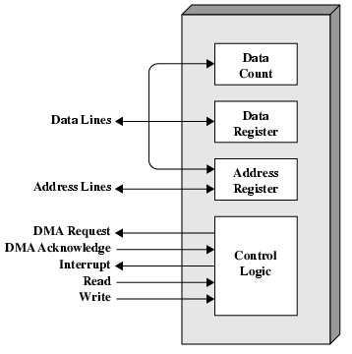
DMA Module Diagram

Slide 29
DMA Operation
CPU tells DMA controller:-
  Read/Write
  Device address
  Starting address of memory block for data
  Amount of data to be transferred
CPU carries on with other work
DMA controller deals with transfer
DMA controller sends interrupt when finished

Slide 30
DMA Transfer
Cycle Stealing
DMA controller takes over bus for a cycle
Transfer of one word of data
Not an interrupt
  CPU does not switch context
CPU suspended just before it accesses bus
  i.e. before an operand or data fetch or a data write
Slows down CPU but not as much as CPU doing transfer

Slide 31
Aside
What effect does caching memory have on DMA?
Hint: how much are the system buses available?

Slide 32
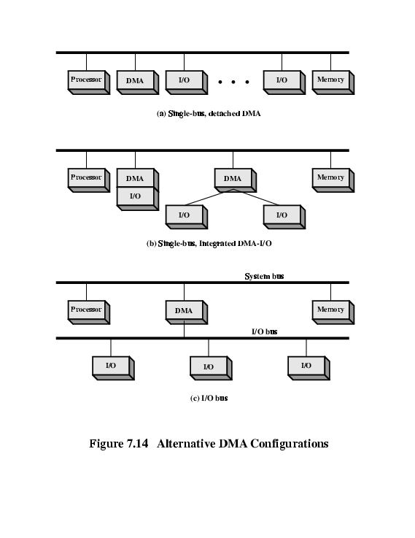
DMA Configurations (1)
Single Bus, Detached DMA controller
Each transfer uses bus twice
  I/O to DMA then DMA to memory
CPU is suspended twice

Slide 33
DMA Configurations (2)
Single Bus, Integrated DMA controller
Controller may support >1 device
Each transfer uses bus once
  DMA to memory
CPU is suspended once

Slide 34
DMA Configurations (3)
Separate I/O Bus
Bus supports all DMA enabled devices
Each transfer uses bus once
  DMA to memory
CPU is suspended once

Slide 35
I/O Channels
I/O devices getting more sophisticated
e.g. 3D graphics cards
CPU instructs I/O controller to do transfer
I/O controller does entire transfer
Improves speed
  Takes load off CPU
  Dedicated processor is faster

Slide 36
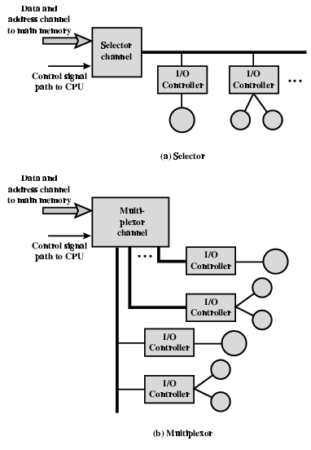
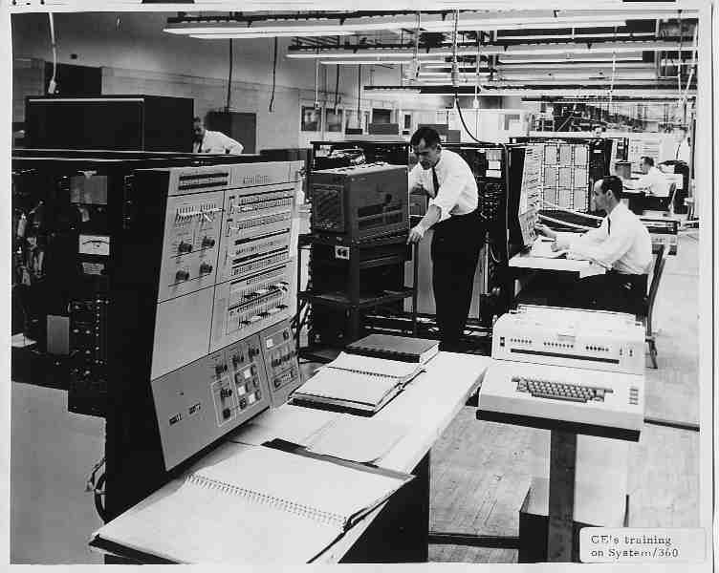
I/O Channel
Architecture

Slide 37
Interfacing
Connecting devices together
Bit of wire?
Dedicated processor/memory/buses?
E.g. FireWire, InfiniBand, Fibre Channel

Slide 38
IEEE 1394 FireWire
High performance serial bus
Fast
Low cost
Easy to implement
Also being used in digital cameras, VCRs and TV

Slide 39
FireWire Configuration
Daisy chain
Up to 63 devices on single port
  Really 64 of which one is the interface itself
Up to 1022 buses can be connected with bridges
Automatic configuration
No bus terminators
May be tree structure

Slide 40
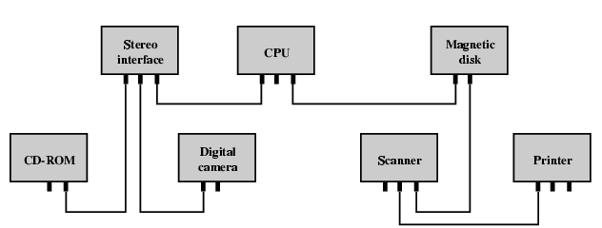
Simple FireWire Configuration

Slide 41
FireWire 3 Layer Stack
Physical
  Transmission medium, electrical and signaling characteristics
Link
  Transmission of data in packets
Transaction
  Request-response protocol

Slide 42
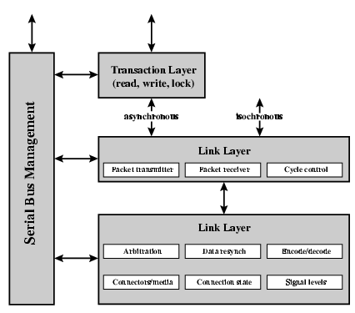
FireWire Protocol Stack

Slide 43
FireWire - Physical Layer
Data rates from 25 to 400Mbps
Two forms of arbitration
  Based on tree structure
  Root acts as arbiter
  First come first served
  Natural priority controls simultaneous requests
    i.e. who is nearest to root
  Fair arbitration
  Urgent arbitration

Slide 44
FireWire - Link Layer
Two transmission types
  Asynchronous
    Variable amount of data and several bytes of transaction data transferred as a packet
    To explicit address
    Acknowledgement returned
  Isochronous
    Variable amount of data in sequence of fixed size packets at regular intervals
    Simplified addressing
    No acknowledgement

Slide 45
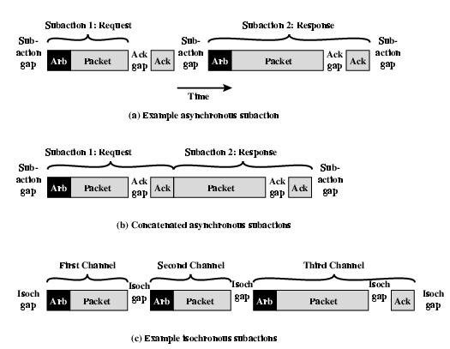
FireWire Sub-actions

Slide 46
InfiniBand
I/O specification aimed at high end servers
  Merger of Future I/O (Cisco, HP, Compaq, IBM) and Next Generation I/O (Intel)
Version 1 released early 2001
Architecture and spec. for data flow between processor and intelligent I/O devices
Intended to replace PCI in servers
Increased capacity, expandability, flexibility

Slide 47
InfiniBand Architecture
Remote storage, networking and connection between servers
Attach servers, remote storage, network devices to central fabric of switches and links
Greater server density
Scalable data centre
Independent nodes added as required
I/O distance from server up to
  17m using copper
  300m multimode fibre optic
  10km single mode fibre
Up to 30Gbps

Slide 48
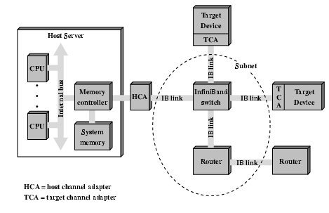
InfiniBand Switch Fabric

Slide 49
InfiniBand Operation
16 logical channels (virtual lanes) per physical link
One lane for management, rest for data
Data in stream of packets
Virtual lane dedicated temporarily to end to end transfer
Switch maps traffic from incoming to outgoing lane

Slide 50
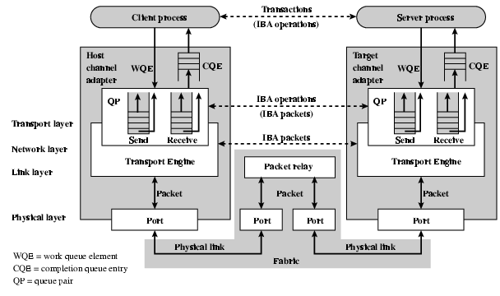
InfiniBand Protocol Stack

Slide 51
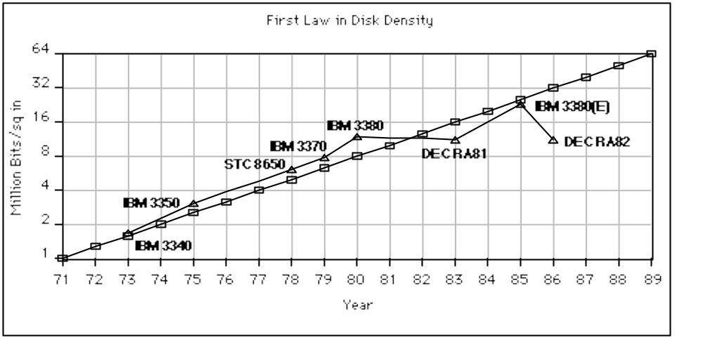
Disk Technology Trends
Disk Capacity
now doubles
every 18 months;
before 1990 every
36 months
• Today: Processing Power Doubles Every 18 months
• Today: Memory Size Doubles Every 18 months(4X/3yr)
• Today: Disk Capacity Doubles Every 18 months
• Disk Positioning Rate (Seek + Rotate) Doubles Every Ten Years!
The I/O
GAP

Slide 52
Storage Technology Drivers
Driven by the prevailing computing paradigm
  1950s: migration from batch to on-line processing
  1990s: migration to ubiquitous computing
    computers in phones, books, cars, video cameras, …
    nationwide fiber optical network with wireless tails
Effects on storage industry:
  Embedded storage
    smaller, cheaper, more reliable, lower power
  Data utilities
    high capacity, hierarchically managed storage

Slide 53
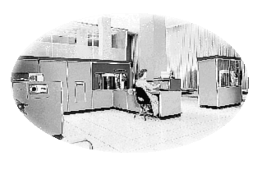
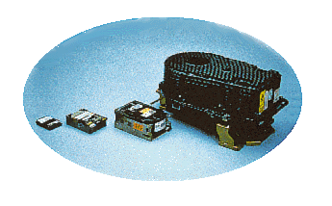
Historical
Perspective
1956 IBM Ramac — early 1970s Winchester
  Developed for mainframe computers, proprietary interfaces
  Steady shrink in form factor: 27 in. to 14 in.
1970s developments
  5.25 inch floppy disk form factor
  early emergence of industry standard
  disk interfaces
    ST506, SASI, SMD, ESDI

Slide 54
Historical Perspective
Early 1980s
  PCs and first generation workstations
Mid 1980s
  Client/server computing
  Centralized storage on file server
    accelerates disk downsizing: 8 inch to 5.25 inch
  Mass market disk drives become a reality
    industry standards: SCSI, IPI, IDE
    5.25 inch drives for standalone PCs, End of proprietary interfaces

Slide 55
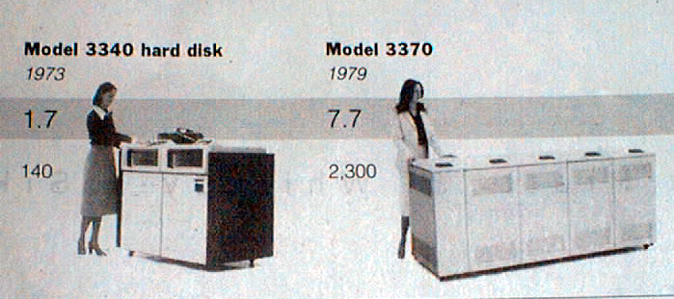
Disk History
Data
density
Mbit/sq. in.
Capacity of
Unit Shown
Megabytes
1973:
1. 7 Mbit/sq. in
140 MBytes
1979:
7. 7 Mbit/sq. in
2,300 MBytes
source: New York Times, 2/23/98, page C3,
“Makers of disk drives crowd even more data into even smaller spaces”

Slide 56
Historical Perspective
Late 1980s/Early 1990s:
  Laptops, notebooks, (palmtops)
  3.5 inch, 2.5 inch, (1.8 inch form factors)
  Form factor plus capacity drives market, not so much performance
    Recently Bandwidth improving at 40%/ year
  Challenged by DRAM, flash RAM in PCMCIA cards
    still expensive, Intel promises but doesn’t deliver
    unattractive MBytes per cubic inch
  Optical disk fails on performance (e.g., NEXT) but finds niche (CD ROM)

Slide 57
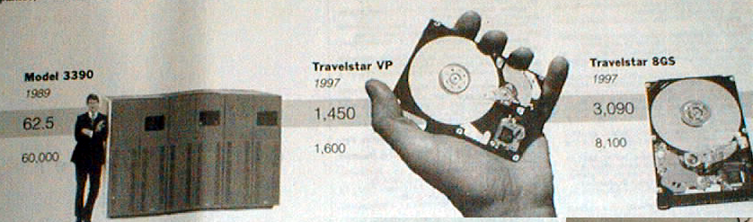
Disk History
1989:
63 Mbit/sq. in
60,000 MBytes
1997:
1450 Mbit/sq. in
2300 MBytes
1997:
3090 Mbit/sq. in
8100 MBytes
source: New York Times, 2/23/98, page C3,
“Makers of disk drives crowd even more data into even smaller spaces”

Slide 58
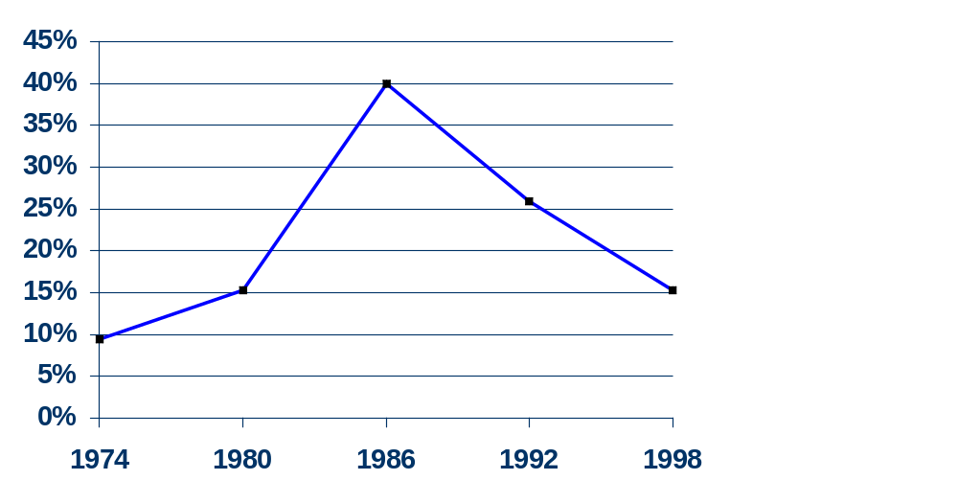
MBits per square inch:
DRAM as % of Disk over time
9 v. 22 Mb/in²
470 v. 3000 Mb/in²
0.2 v. 1.7 Mb/si

Slide 59
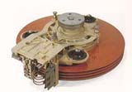
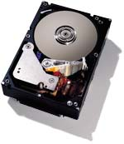
Magnetic Disk Technology
Purpose:
  Long-term, nonvolatile storage
  Large, inexpensive, slow level in the storage hierarchy
Characteristics:
  Seek Time (~8 ms avg)
    positional latency
    rotational latency
Transfer rate
  About a sector per ms
  (5-15 MB/s)
  Blocks
Capacity
  Gigabytes
  Quadruples every 3 years
  (aerodynamics)
Track
Sector
Cylinder
Platter
Head
7200 RPM = 120 RPS => 8 ms per rev
ave rot. latency = 4 ms
128 sectors per track => 0.25 ms per sector
1 KB per sector => 16 MB / s
Response time
= Queue + Controller + Seek + Rot + Xfer
Service time

Slide 60
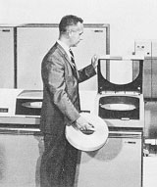
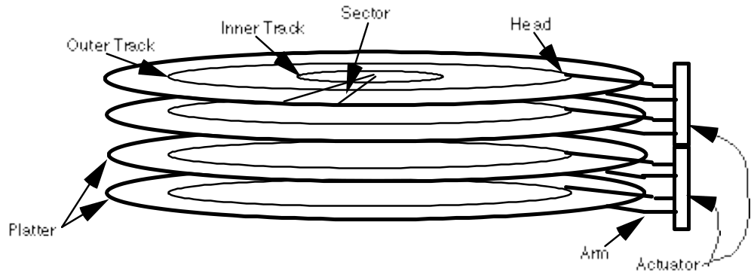
Disk Device Terminology
Disk Latency = Queuing Time + Controller time +
Seek Time + Rotation Time + Transfer Time
Order of magnitude times for 4K byte transfers:
Seek: 8 ms or less
Rotate: 4.2 ms @ 7200 rpm
Transfer: 1 ms @ 7200 rpm

Slide 61
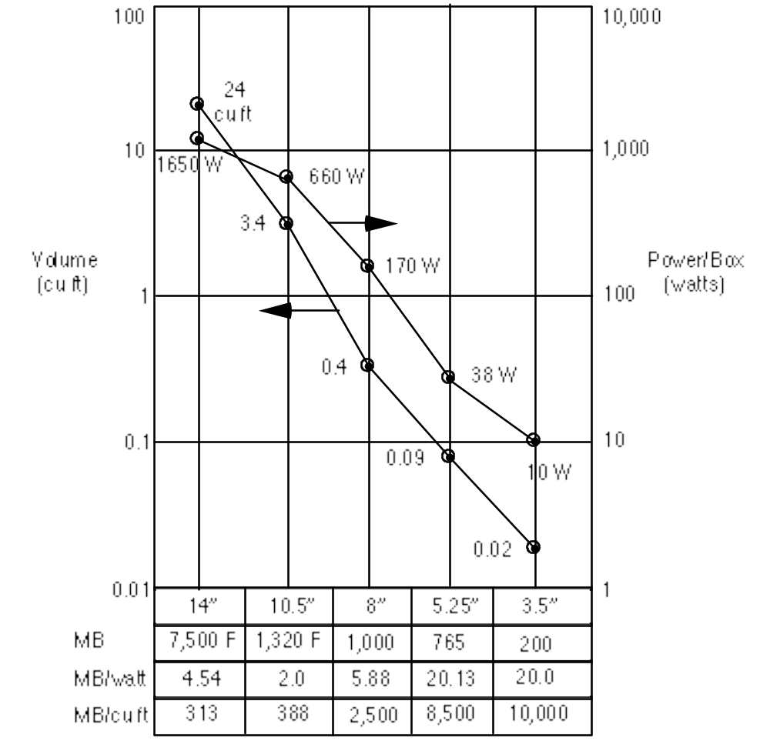
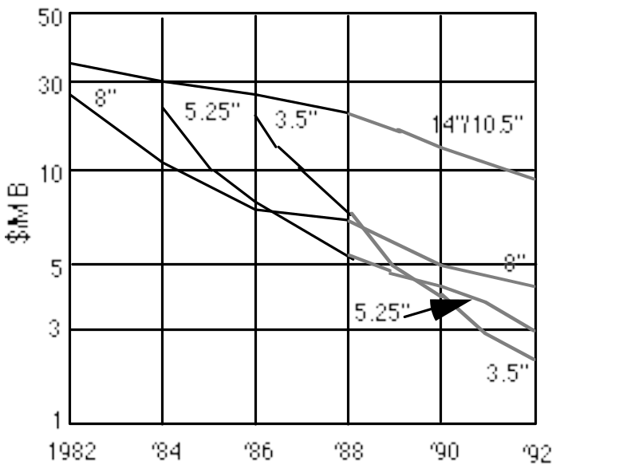
Advantages of Small Form-factor Disks
Low cost/MB
High MB/volume
High MB/watt
Low cost/Actuator
Cost and Environmental Efficiencies

Slide 62
Tape vs. Disk
• Longitudinal tape uses same technology as
hard disk; tracks its density improvements
Disk head flies above surface, tape head lies on surface
Disk fixed, tape removable
• Inherent cost-performance based on geometries:
fixed rotating platters with gaps
(random access, limited area, 1 media / reader)
vs.
removable long strips wound on spool
(sequential access, "unlimited" length, multiple / reader)
• New technology trend:
Helical Scan (VCR, Camcoder, DAT)
Spins head at angle to tape to improve density

Slide 63
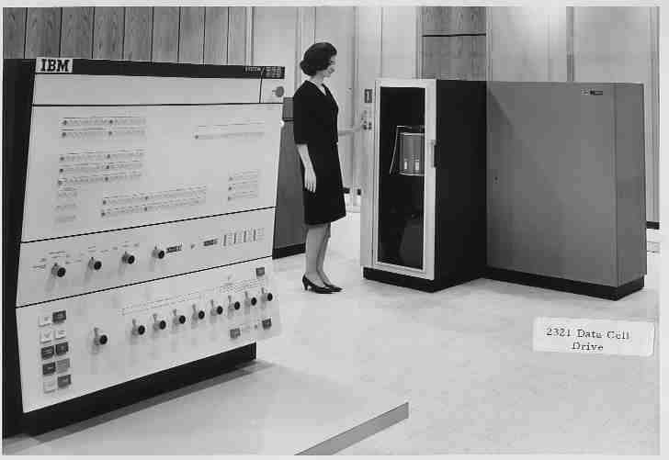
Convenience of disk /
Capacity of Tape
IBM 2321
Data Cell
Late 60’s
--
400 Mbytes!

Slide 64
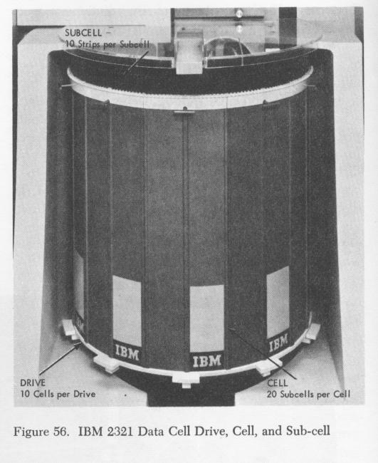
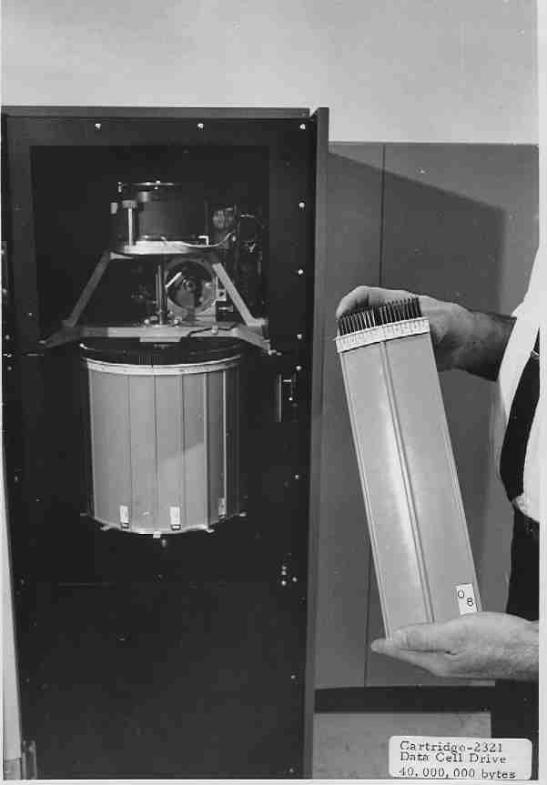
IBM 2321 Magnetic Strips
Strip access
175-600ms

Slide 65
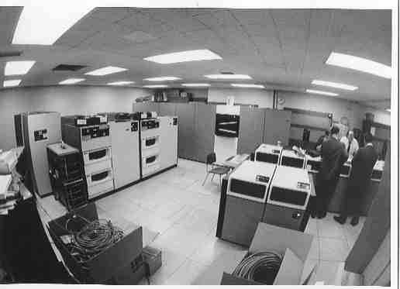
3850 “Mass Storage” System
“Virtual disk”
IBM 3330
“Staging Disks”

Slide 66
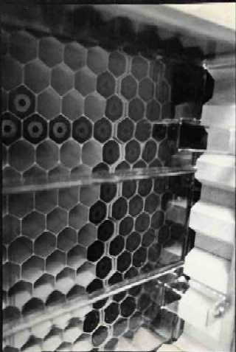
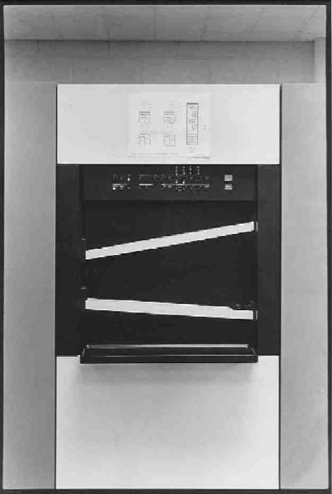
IBM 3850 Honeycomb
2000 Cartridges
50 Mbytes Each!

Slide 67
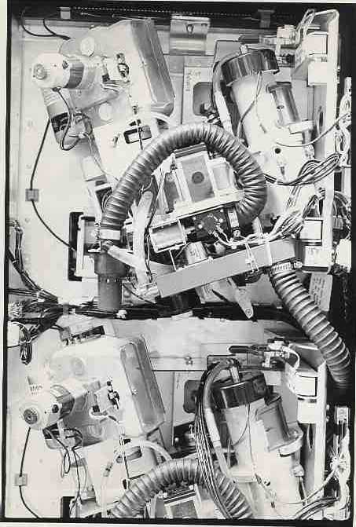
IBM 3850 Data Recording Device

Slide 68
Drawbacks to Magnetic Tape
Tape wears out!
  Helical 100s of passes to 1000s for longitudinal
Heads wear out!
  2000 hours for helical
Both must be accounted for in economic / reliability model
Long rewind, eject, load, spin-up times;
not inherent, just no need in marketplace (so far)
Designed for archival storage

Slide 69
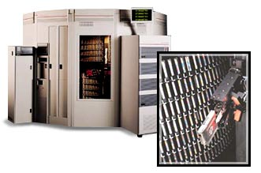
Automated Cartridge
Libraries
STC 4400
8 feet
10 feet
6000 x 0.8 GB 3490 tapes = 5 TBytes in 1992 $500,000 O.E.M. Price
6000 x 10 GB D3 tapes = 60 TBytes in 1998
Library of Congress: all information in the world; in 1992, ASCII of all books = 30 TB

Slide 70
Disk I/O Performance
300
Response
Time (ms)
Metrics:
Response Time
Throughput
200
100
0
100%
0%
Throughput
(% total BW)
Queue
Proc
IOC
Device
Response time = Queue + Device Service time

Slide 71
Disk Time Example
Disk Parameters:
  Transfer size is 8K bytes
  Advertised average seek is 12 ms
  Disk spins at 7200 RPM
  Transfer rate is 4 MB/sec
Controller overhead is 2 ms
Assume that disk is idle so no queuing delay
What is Average Disk Access Time for a Sector?
  Avg seek + avg rot delay + transfer time + controller overhead
  12 ms + 0.5/(7200 RPM/60) + 8 KB/4 MB/s + 2 ms
  12 + 4.15 + 2 + 2 = 20 ms
Advertised seek time assumes no locality: typically 1/4 to 1/3 advertised seek time: 20 ms => 12 ms

